Slide 1

Presentation Of Meeting Assistant

Slide 2
Summary
FireFlies
Otter
TL;DV
FATHOM

Slide 3
Fireflies
Enterprise $39 Per seat/month billed annually
Business $19 Per seat/month billed annually
Pro $10 Per seat/month billed annually
Free $0
More information

Slide 4
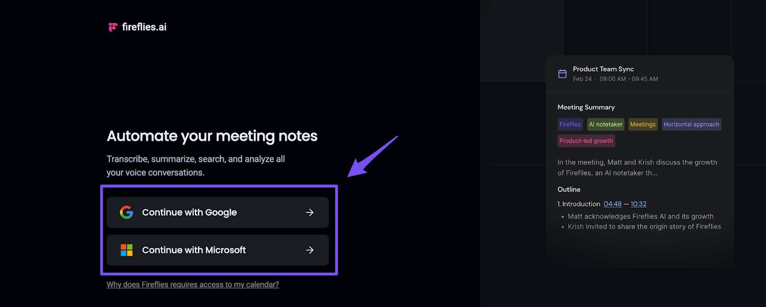
Fireflies
Create a Fireflies account using your Google or Outlook email ID and give Fireflies access to your calendar.

Slide 5
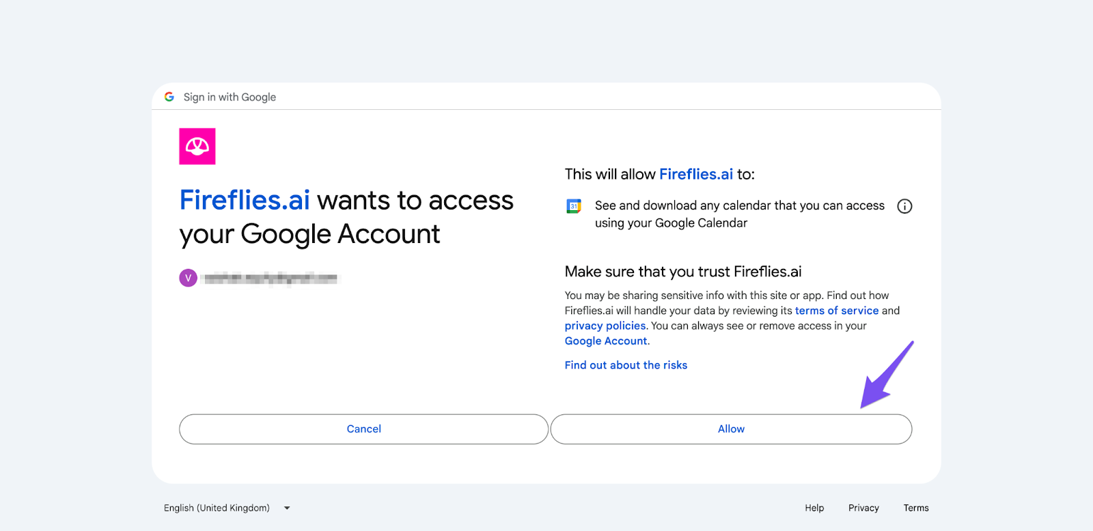
Fireflies
Fireflies connects with your Google or Outlook calendar and joins web conferencing links from your scheduled meetings. This could be Zoom, Gmeet, Skype, WebEx, or any of these popular Web conferencing platforms.

Slide 6
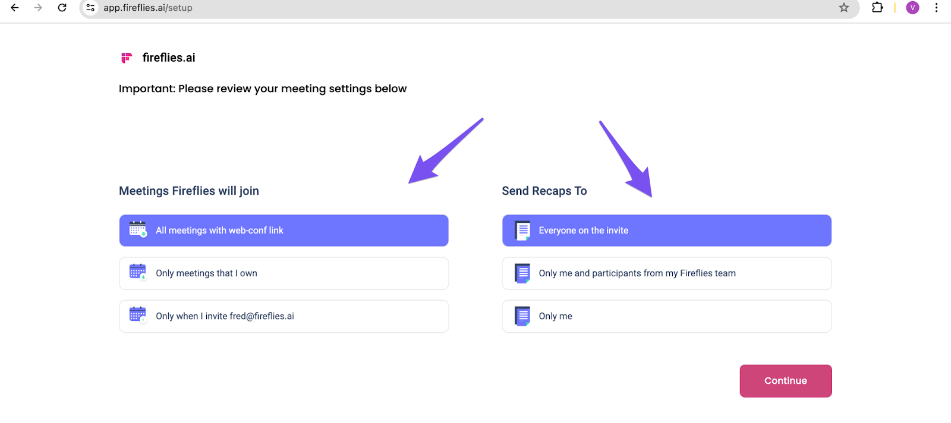
Fireflies
Set up Fireflies to auto-join and share meeting recaps only for the meetings and people you specify.

Slide 7
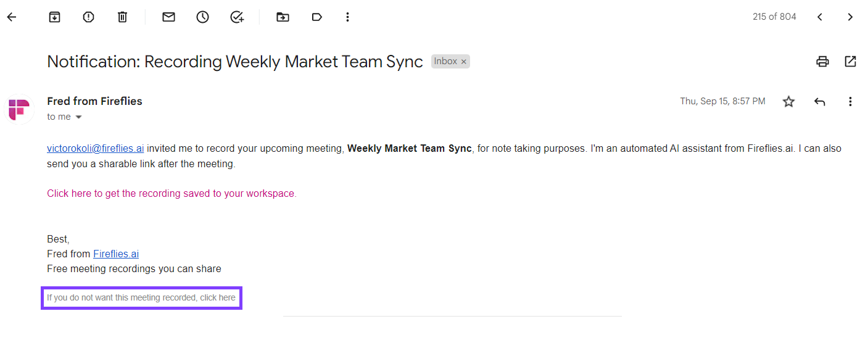
Fireflies
Fireflies sends an email to meeting participants one hour before each meeting, notifying that it will record the meeting for note-taking.

Slide 8
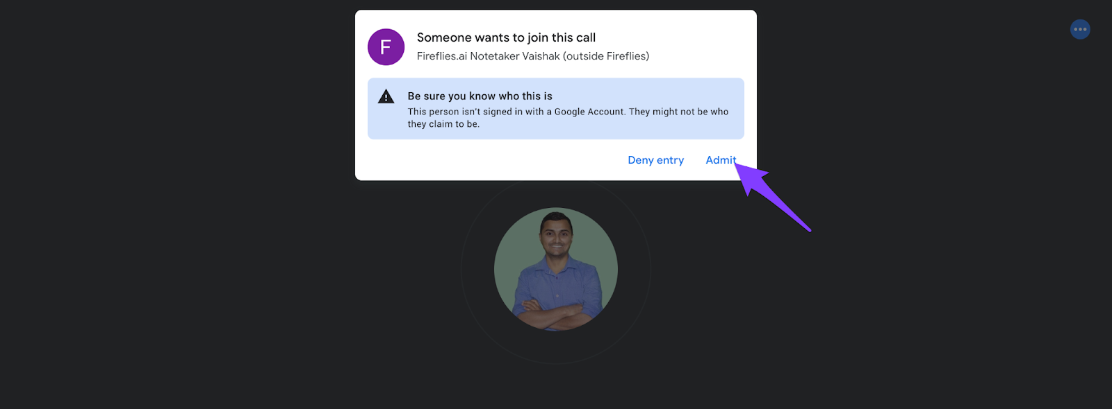
Fireflies
Fireflies will join the meeting a few minutes before the start time. It will then ask permission to join the meeting and the meeting host will receive a prompt.

Slide 9
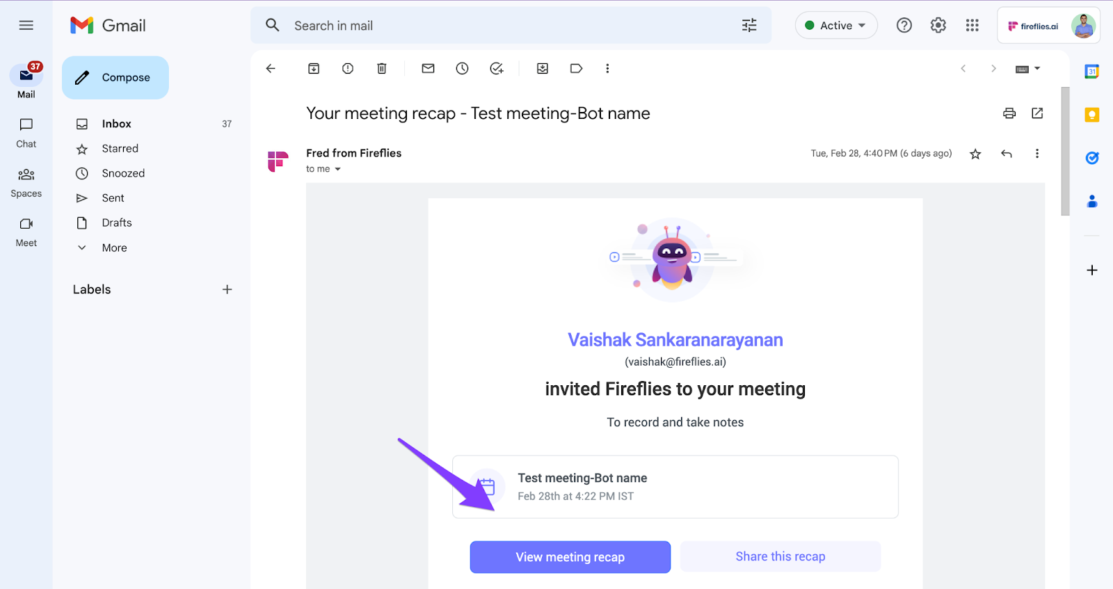
Fireflies
Within 5-10 minutes after a meeting, Fireflies processes the transcript and sends meeting recap emails to you and/or participants based on your configured settings.

Slide 10
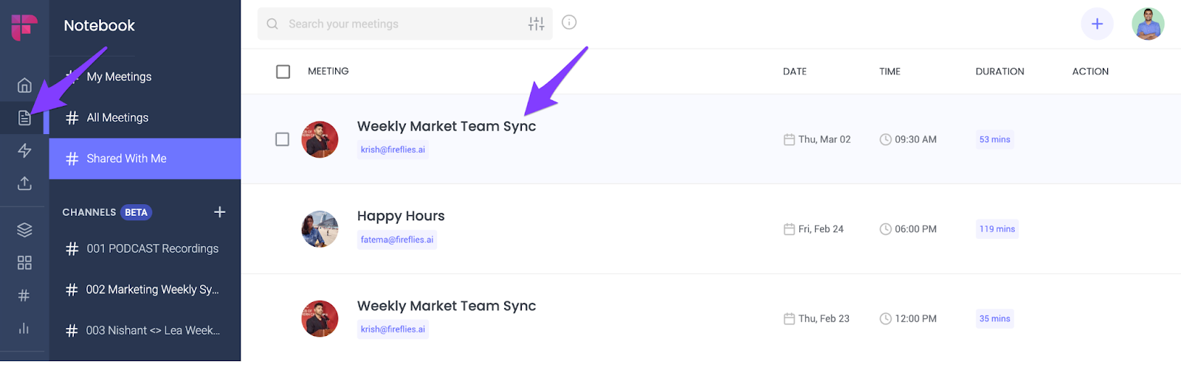
Fireflies
The final meeting will be available in your Fireflies Notebook. Click on the meeting to view the transcripts, summaries, and conversation analytics.

Slide 11
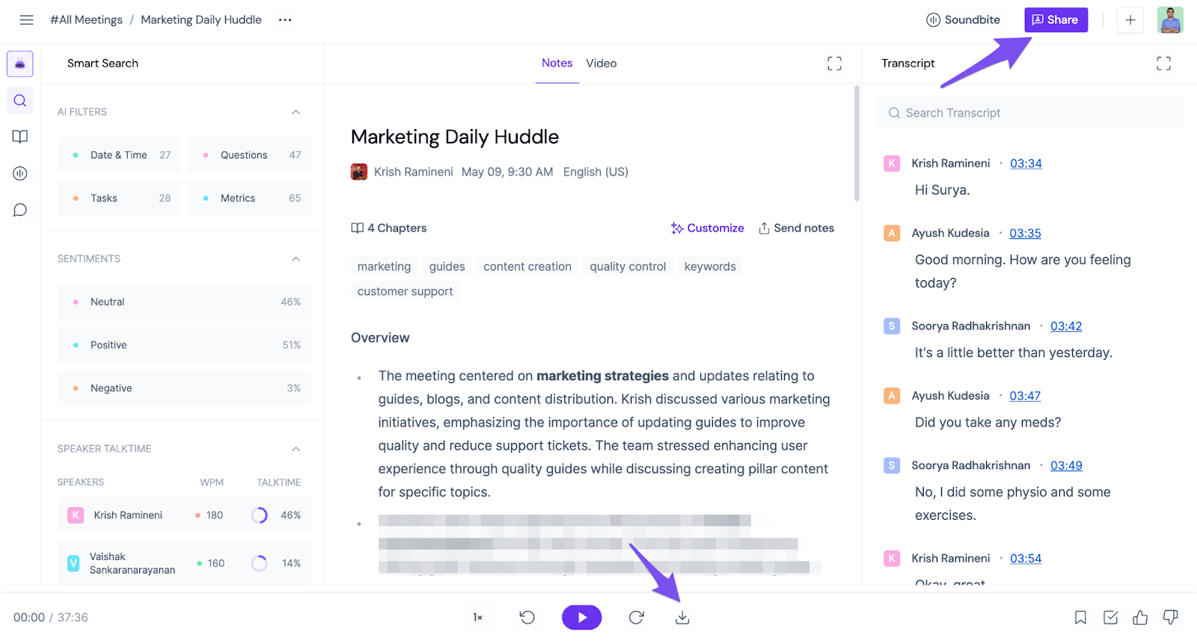
Fireflies
8. You can edit, share, and download the transcripts and recordings.

Slide 12
Otter
Premium Plan: $9.99 per month
Basic Plan: Free
https://otter.ai/pricing

Slide 13
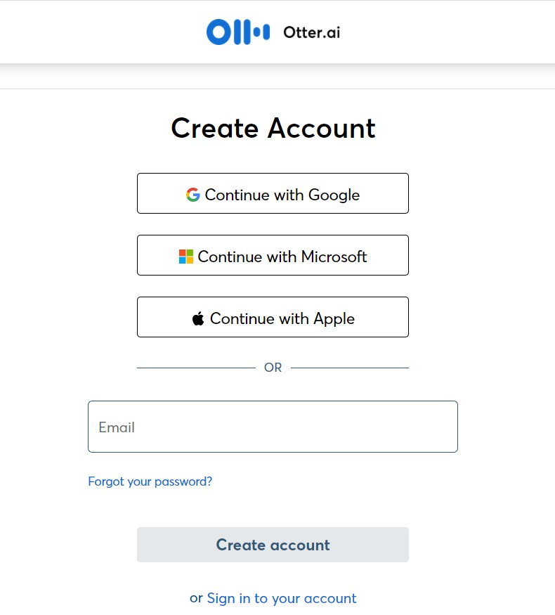
Otter
To begin, go to https://otter.ai/ and click on “Sign Up” to create a free account. If you have the paid version, you will go to https://otter.ai/ and click “Log in.” If you choose “Continue with Microsoft” you can link to your CSU email.
Or download “Otter Voice Meeting Notes” for Android or iOS. Accounts will be linked by email.

Slide 14
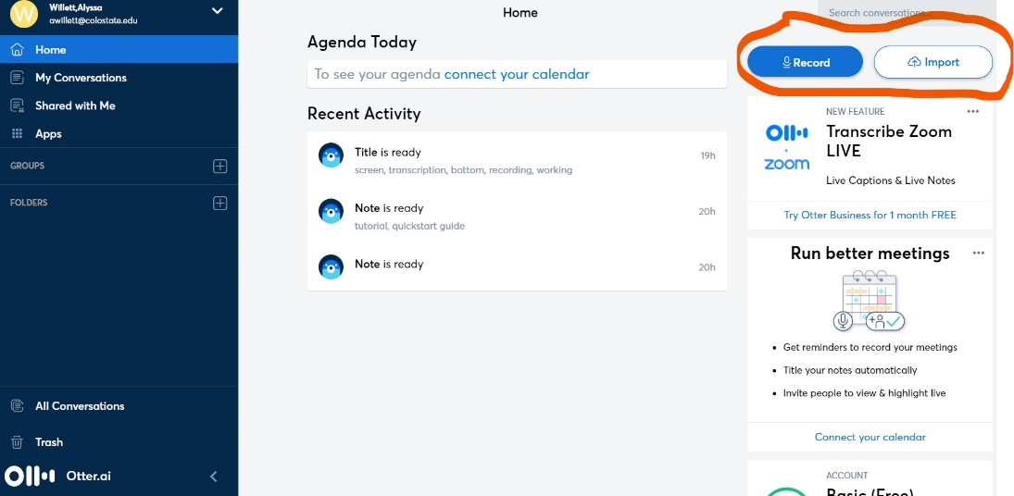
Otter
2. Click next to reach the home page. You will see a menu bar and options to record or import.

Slide 15
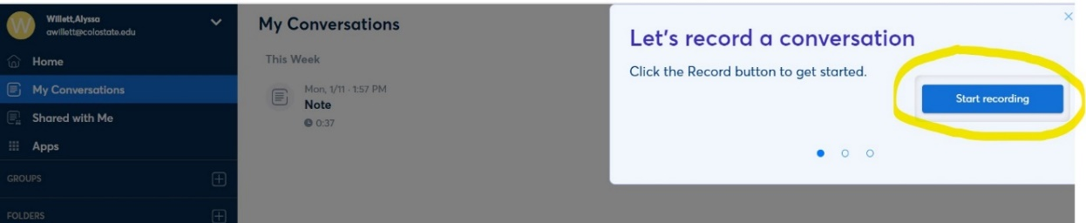
Otter
3.To begin recording notes, you can click on “record” from the home page, or you can choose “Start recording” on the “My Conversations” page

Slide 16
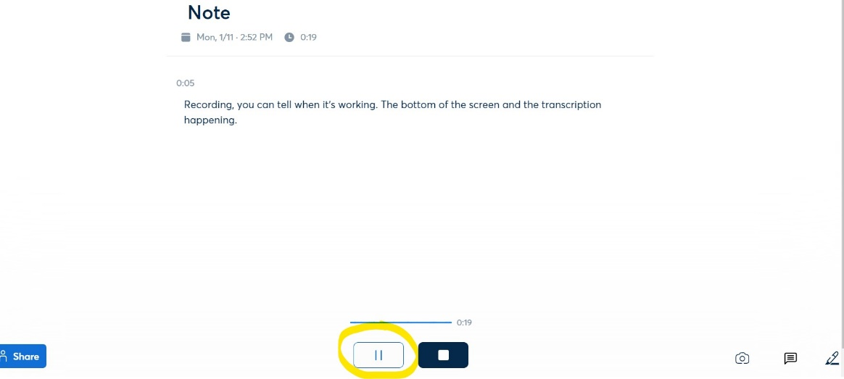
Otter
4. You will know that Otter is recording by the timer at the bottom of the screen. You may pause the recording with the pause button.

Slide 17
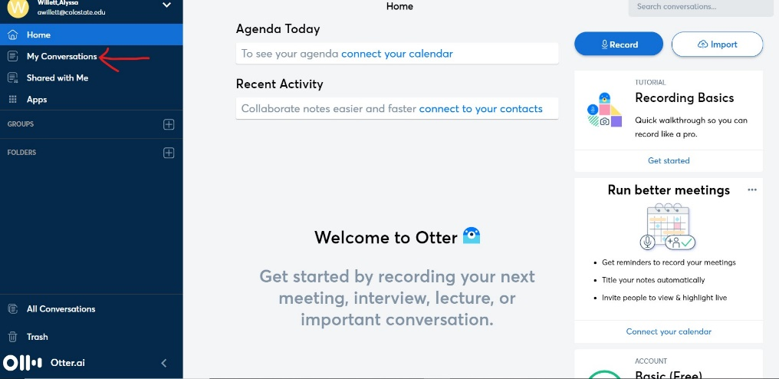
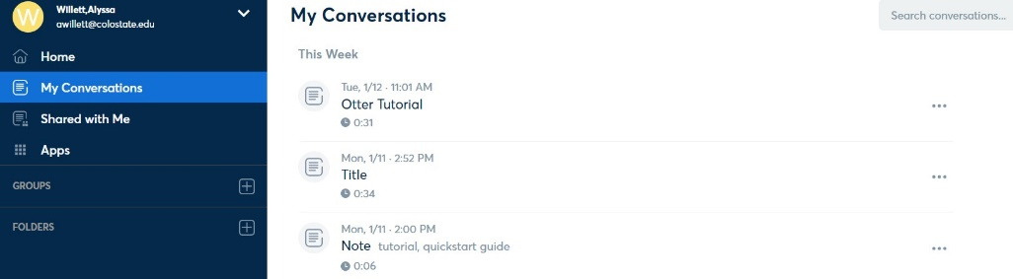
Otter
5.You will find your transcribed note under “My Conversations” in the menu. Each conversation is automatically labeled “Note” and contains the date and time of the recording.

Slide 18
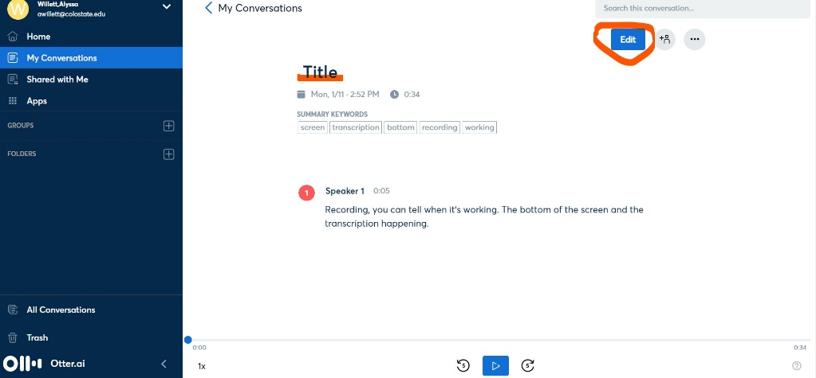
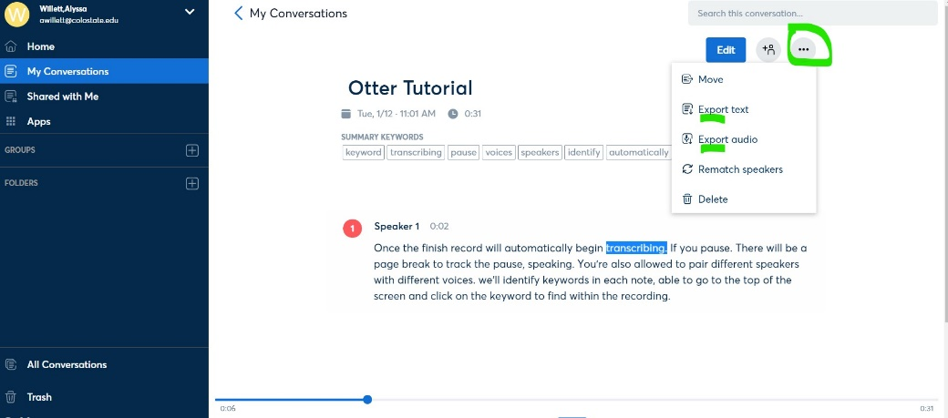
Otter
6.You can listen to your note while reading the transcription by clicking the play button at the bottom of the screen. Otter will highlight each word of the transcription as it is played back. You can check for accuracy.

Slide 19
Tl;dv
Business $59 Per seat/month billed annually
Pro $18 Per seat/month billed annually
Free $0
More information

Slide 20
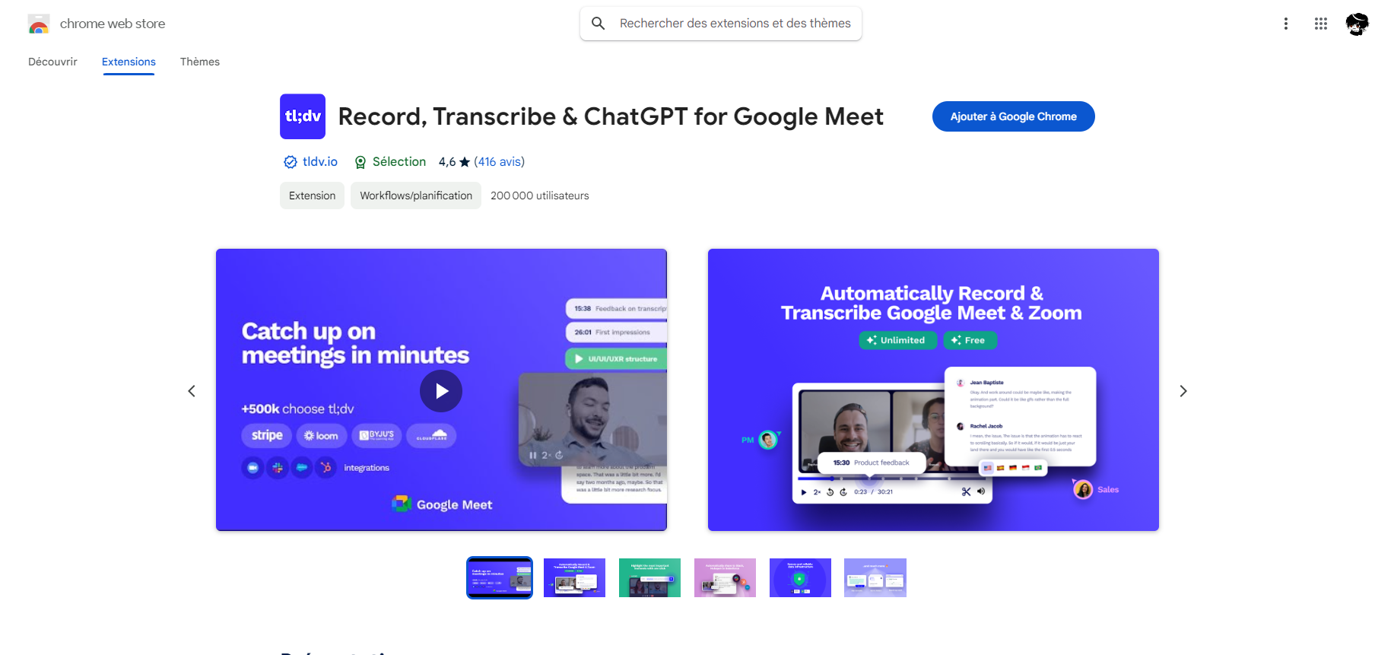
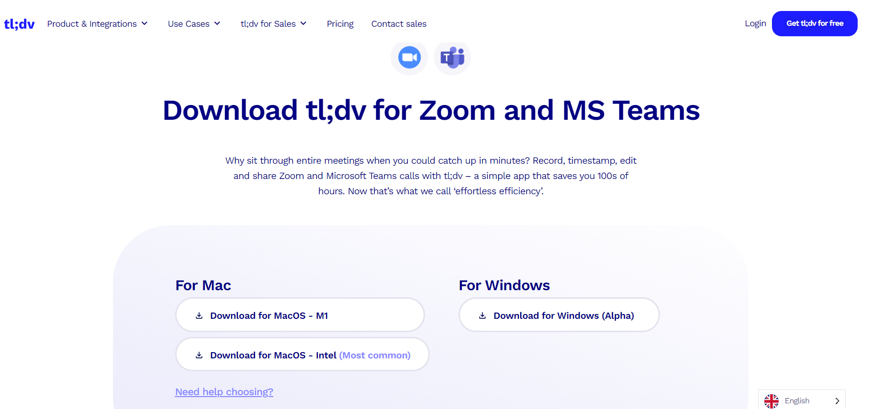
Tl;dv
Get the Tl;dv chrome extension or download the desktop app ; https://tldv.io/desktop-app/

Slide 21
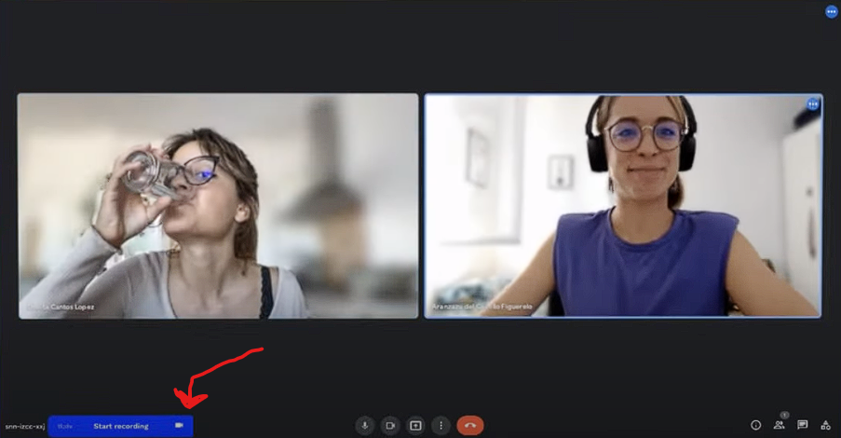
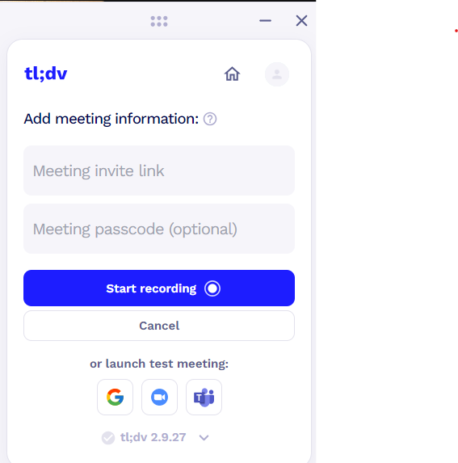
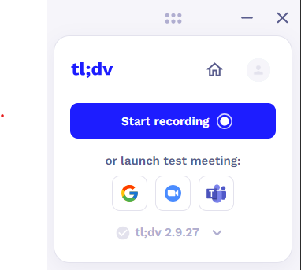
Tl;dv
2. Click on the blue button if you are in the chrome extension or add the meeting information for the desktop app, a new user call tl;dv join the meeting

Slide 22
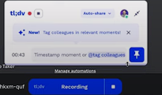
Tl;dv
3. You can comment and pin information when you click on the blue button during the meeting

Slide 23
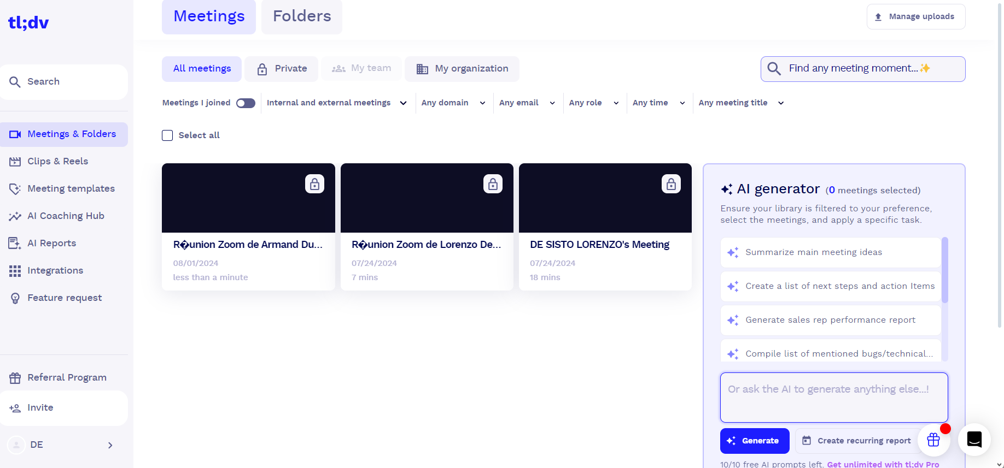
Tl;dv
4. On the web site you have access to all the previous meeting, click on one of them to have access of the page edit/download the transcription

Slide 24
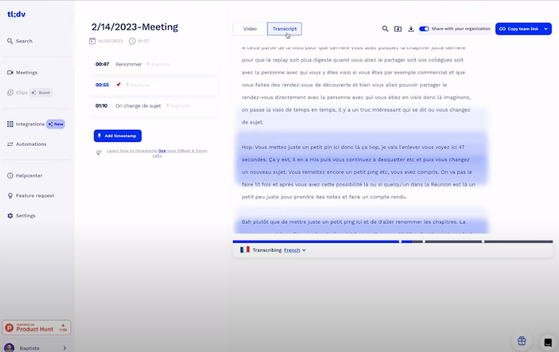
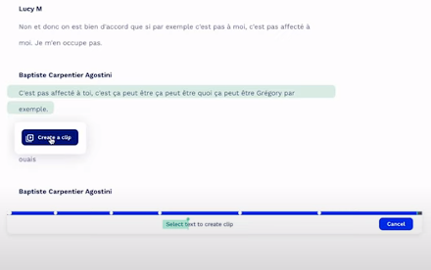
Tl;dv
4. You select just a part of the text to create clip

Slide 25
Fathom
FREE
Premium $15/month per user
Team Edition $19/mo per user
Team Edition Pro $29/mo
More information

Slide 26
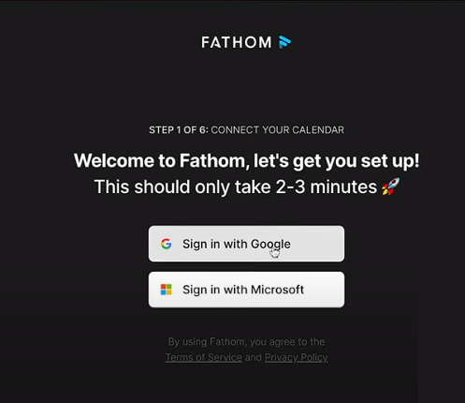
FATHOM
1. Connect Your Calendar:
You can connect Fathom to your Google or Microsoft calendar. Currently, Fathom is only able to connect with these two calendar platforms.
2. Download the Desktop app
https://electron-update.fathom.video/download/exe

Slide 27
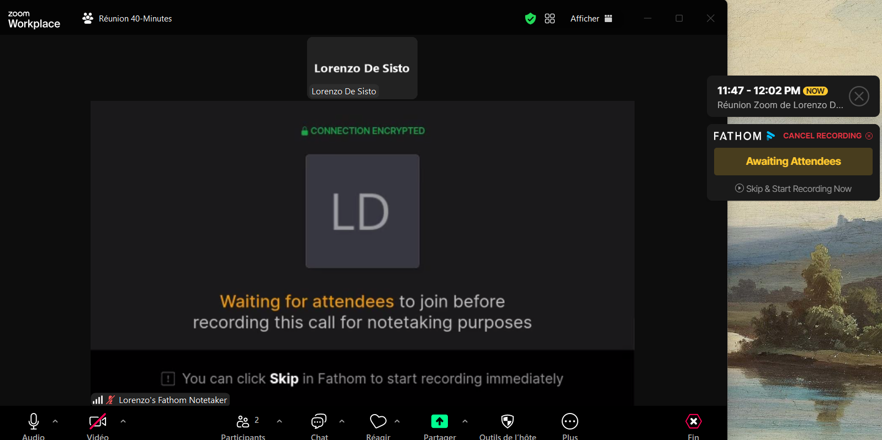
FATHOM
3. Sign into the desktop app
After All the configuration fathom (sign it …) fathom can join your meeting automatically, it waiting until an other participant join but you can skip and directly talk alone

Slide 28
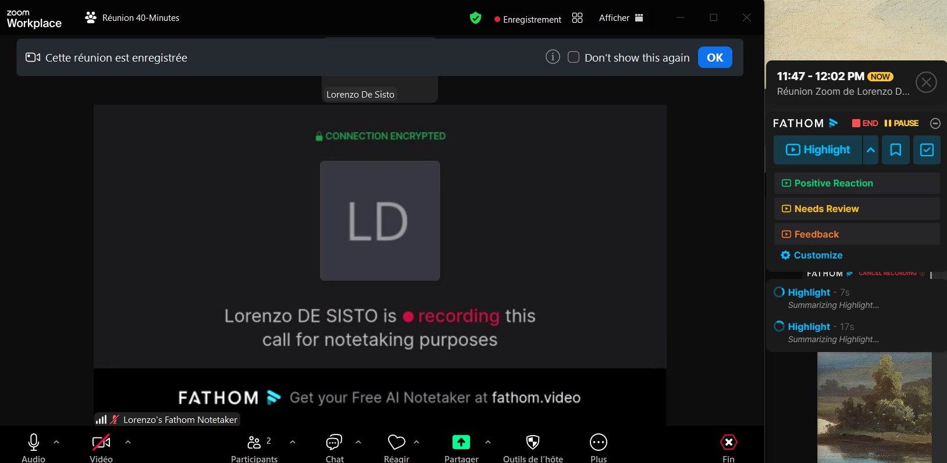
FATHOM
4. Fanthom Have lots of feature
Highlight: Capture short snippets to emphasize key information during discussions.
Feedback: Collect and analyze feedback from users to improve features and usability.
Needs Review: Periodically review and refine features to ensure they meet user needs and expectations.

Slide 29
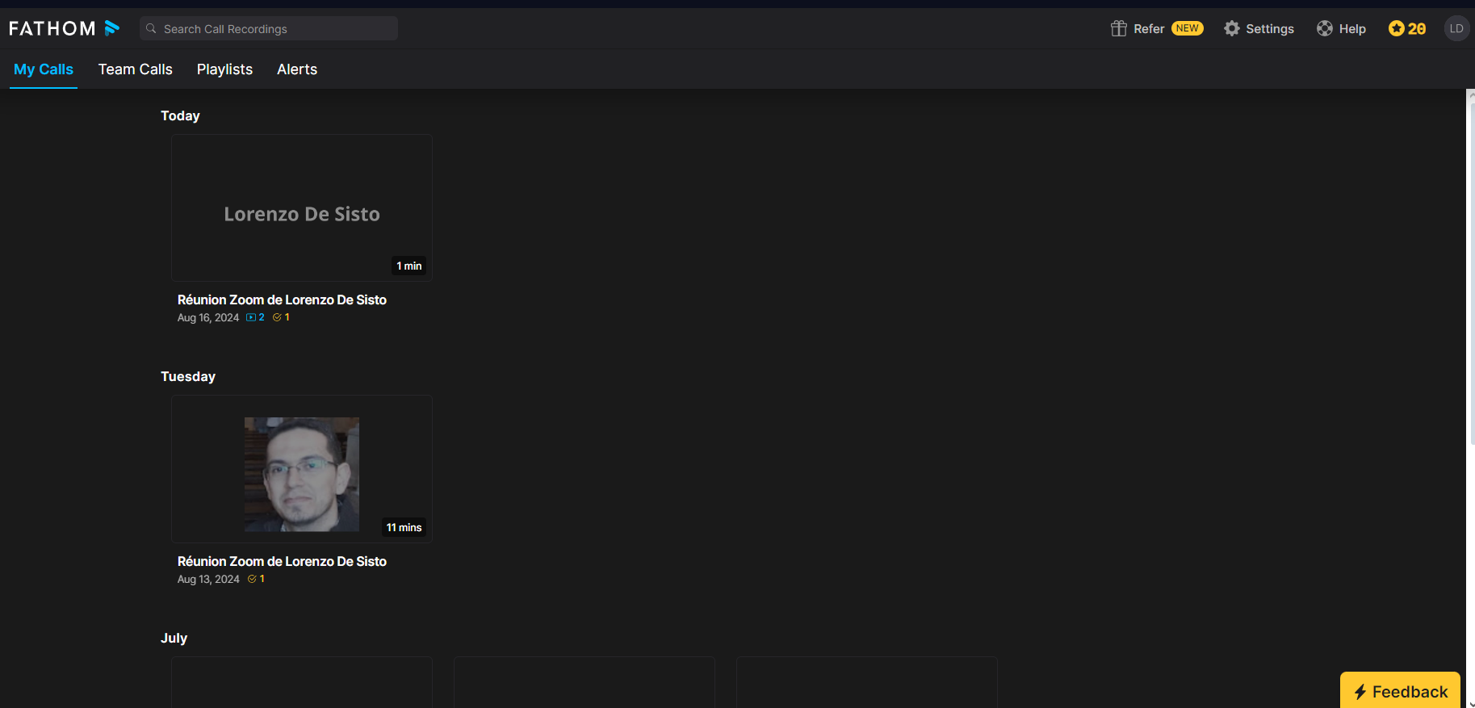
FATHOM
5. in the fathom website at https://fathom.video/home
All the previous meeting are saved, click one to have access of the different feature

Slide 30
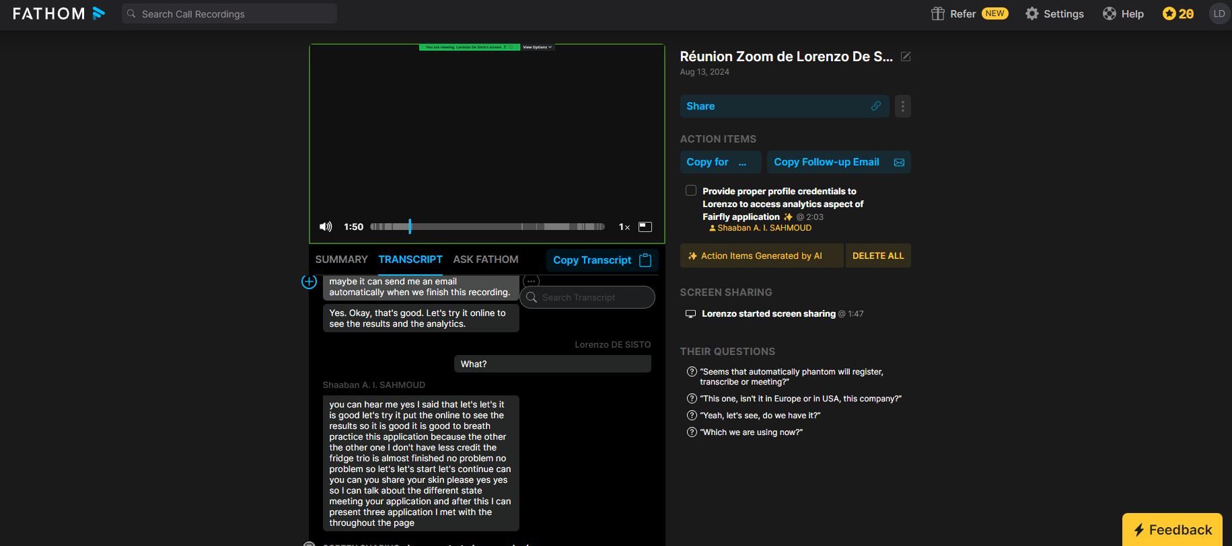
FATHOM
6. After click on a previous meeting you have access :
-The summarization of the meeting
-The transcription, you can edit and highlighting part of the speech
-The ai chat bot to search information
- have the possibility to share on the right of the page

